Slide 1
Two-Fabric Applique
Presented by Karen Pickford

Slide 2
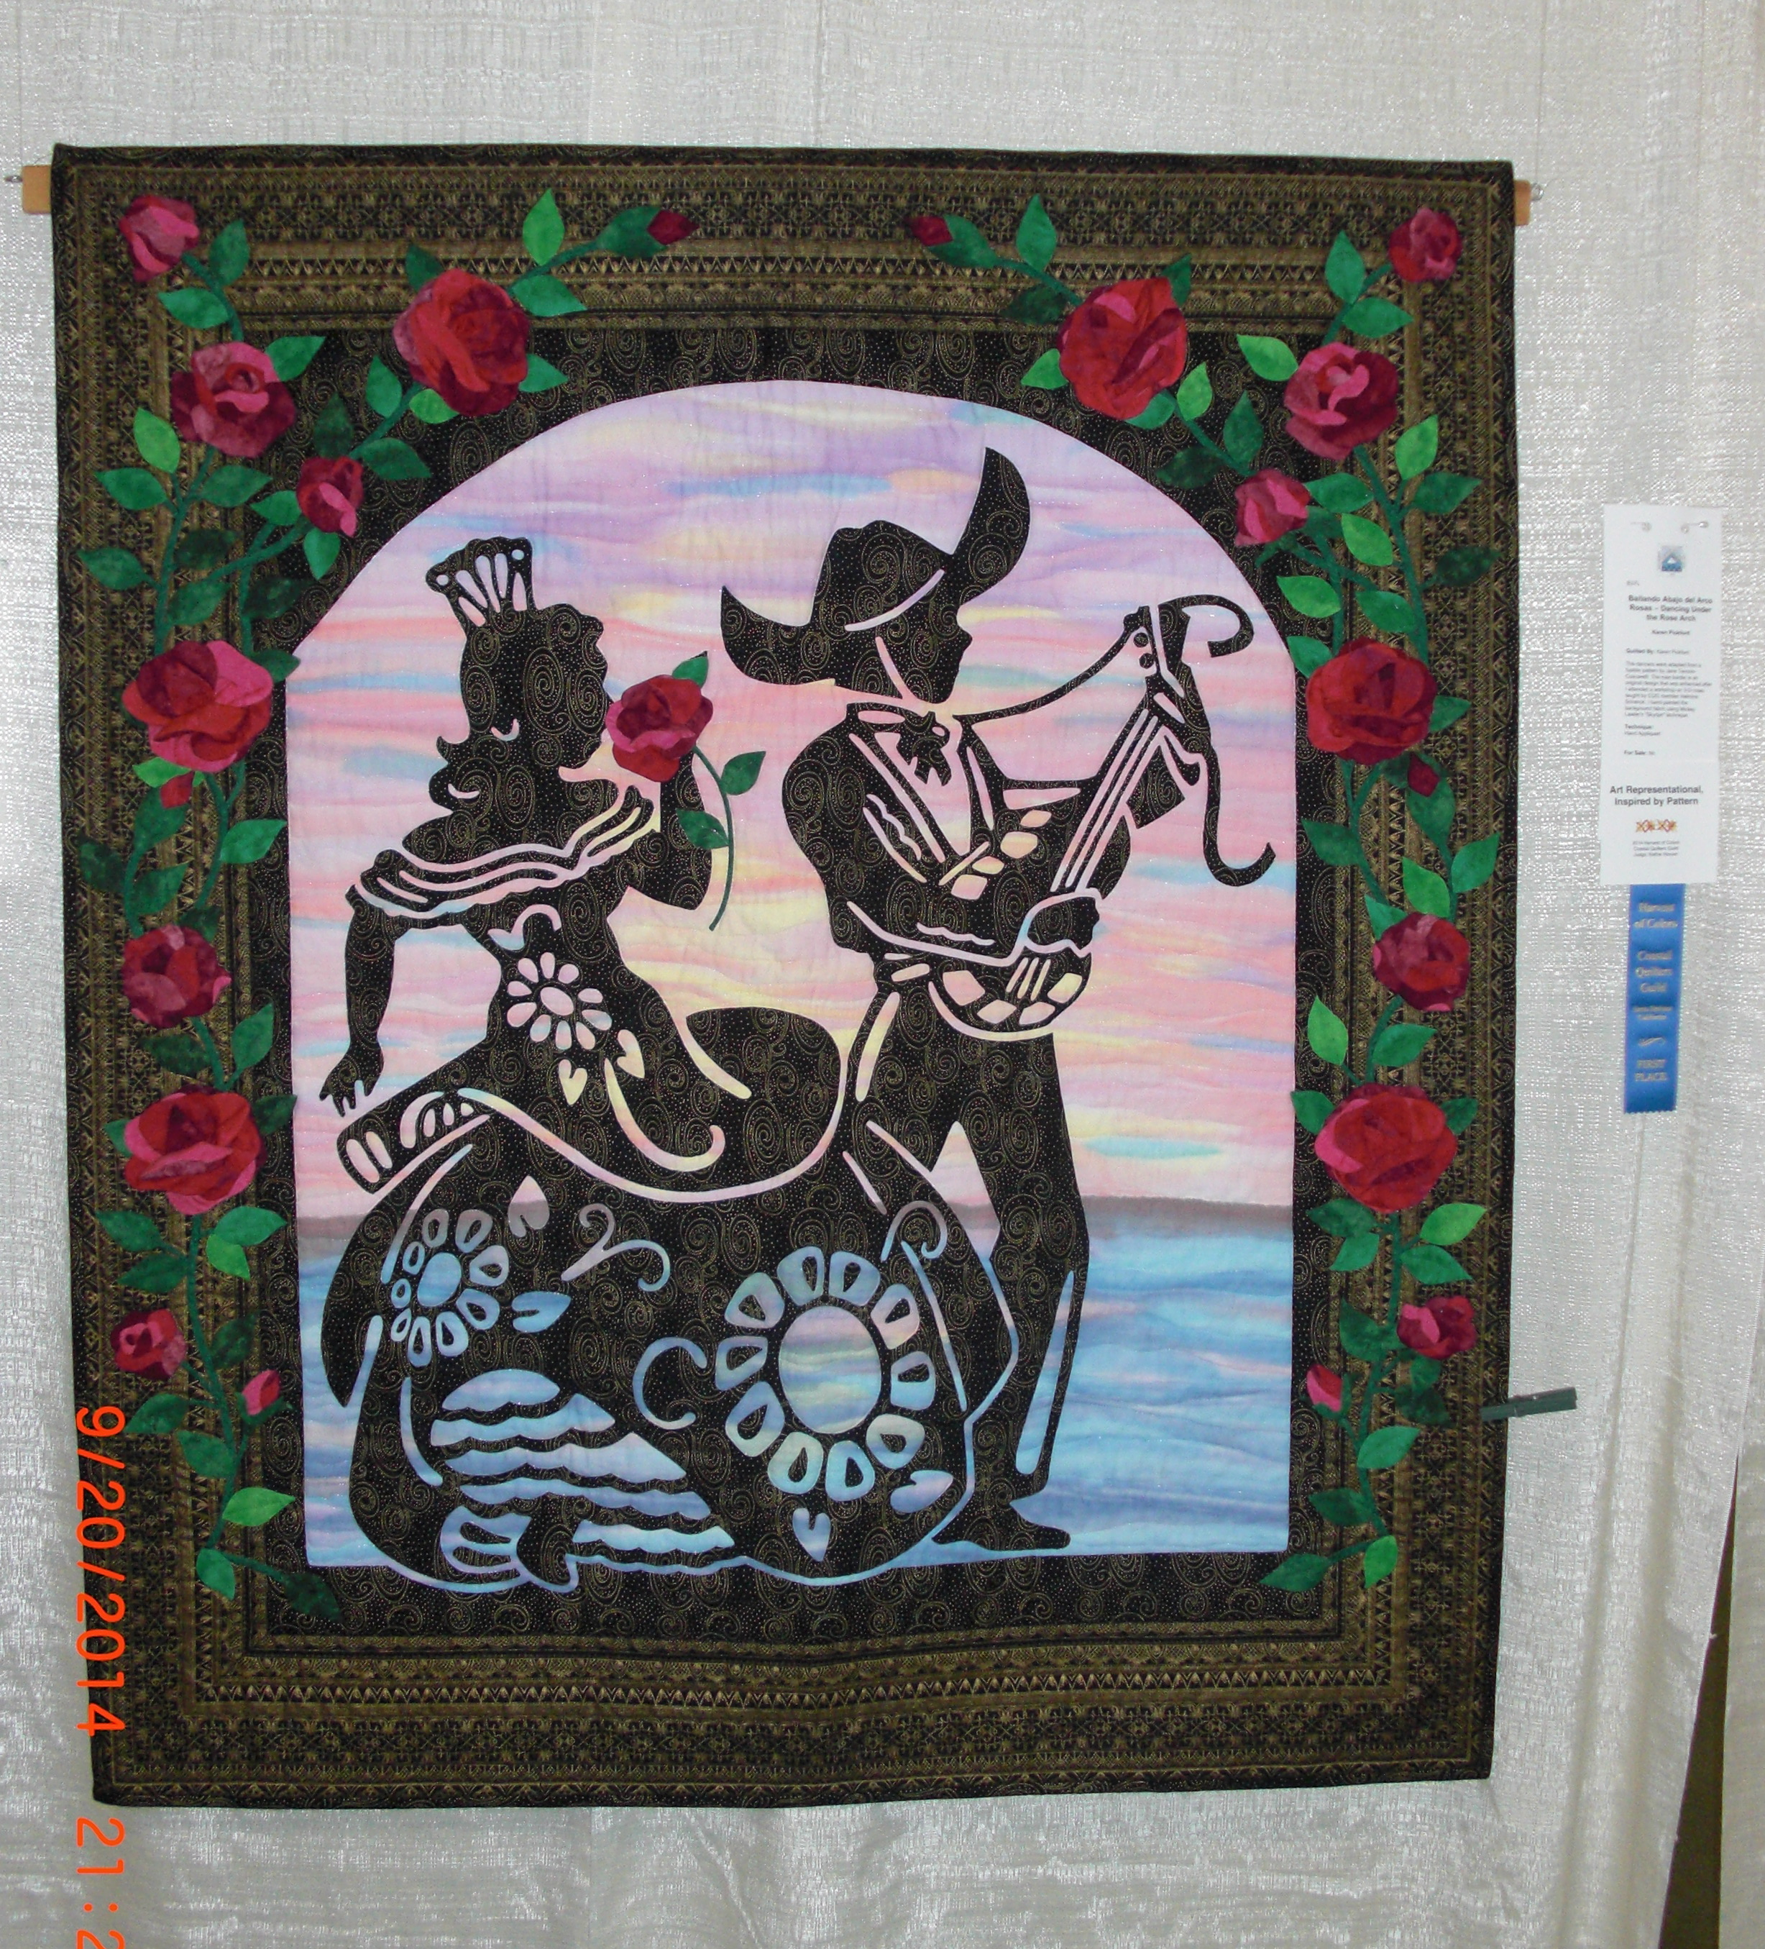

Slide 3
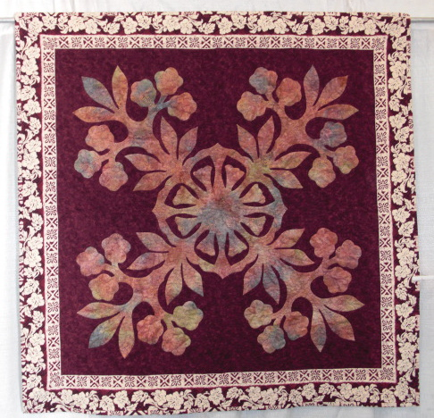

Slide 4
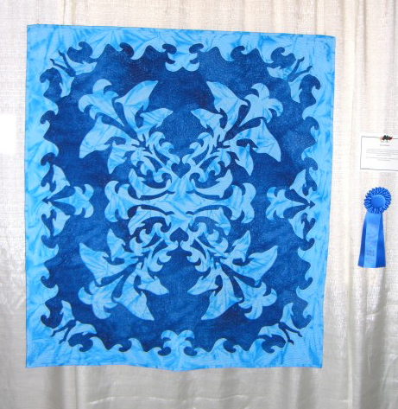

Slide 5
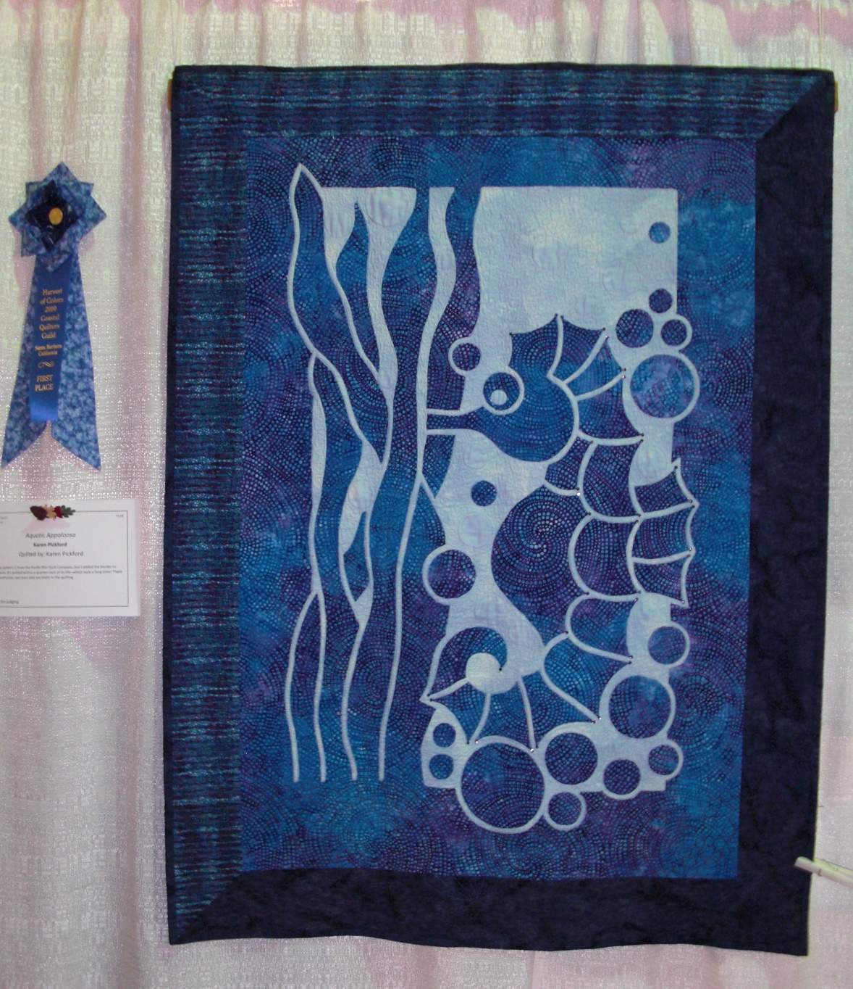

Slide 6
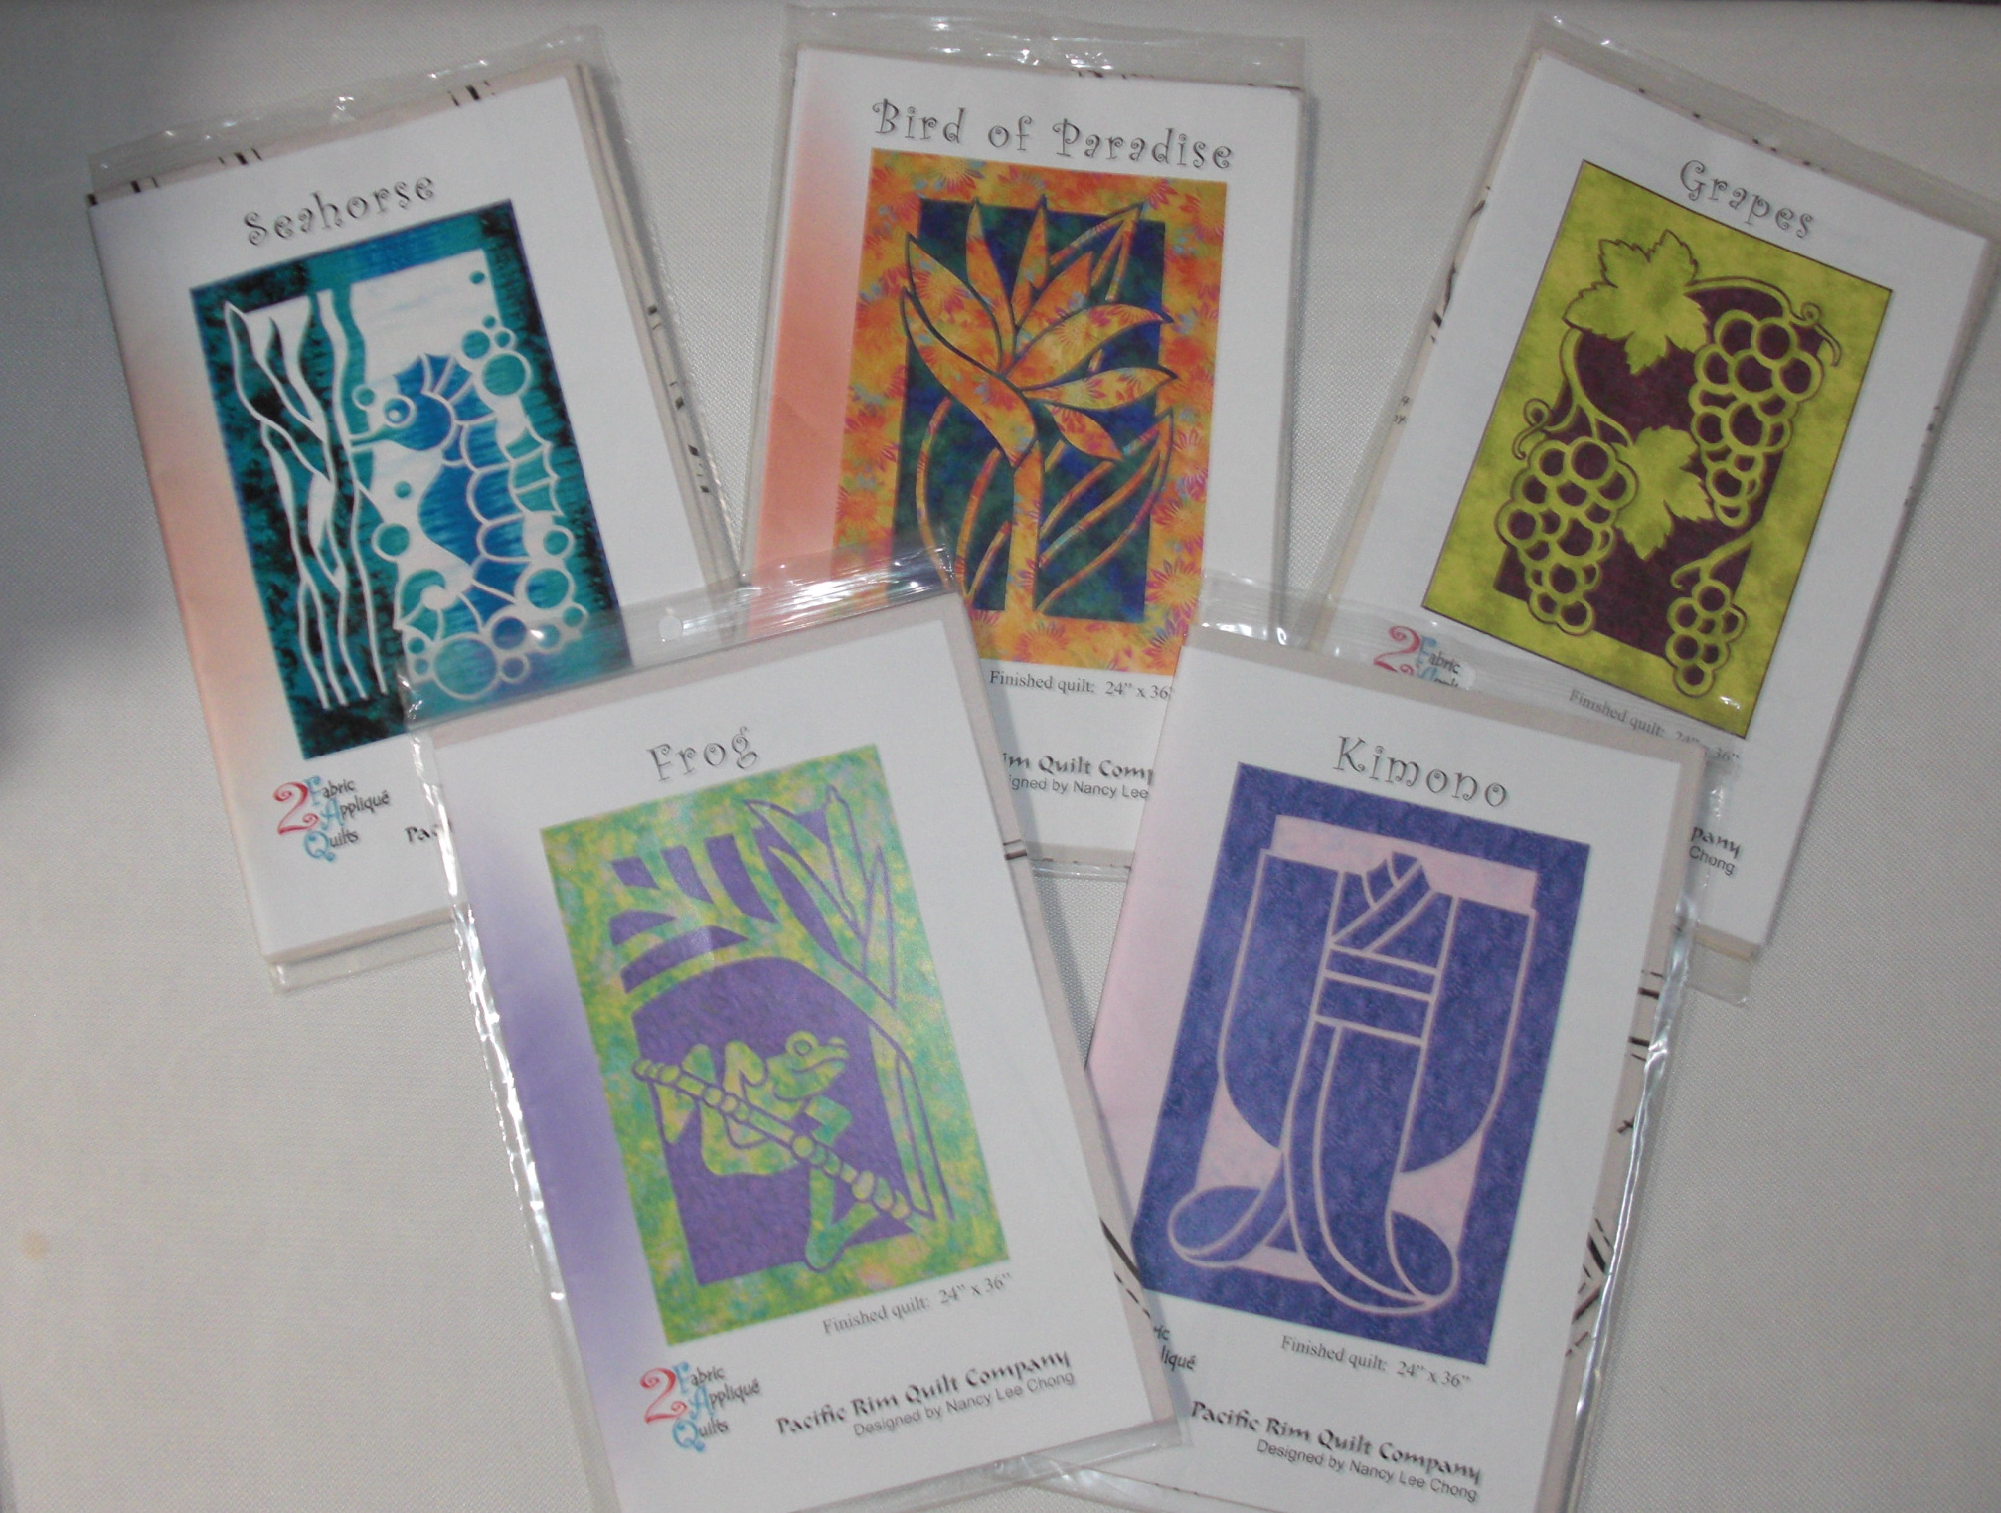
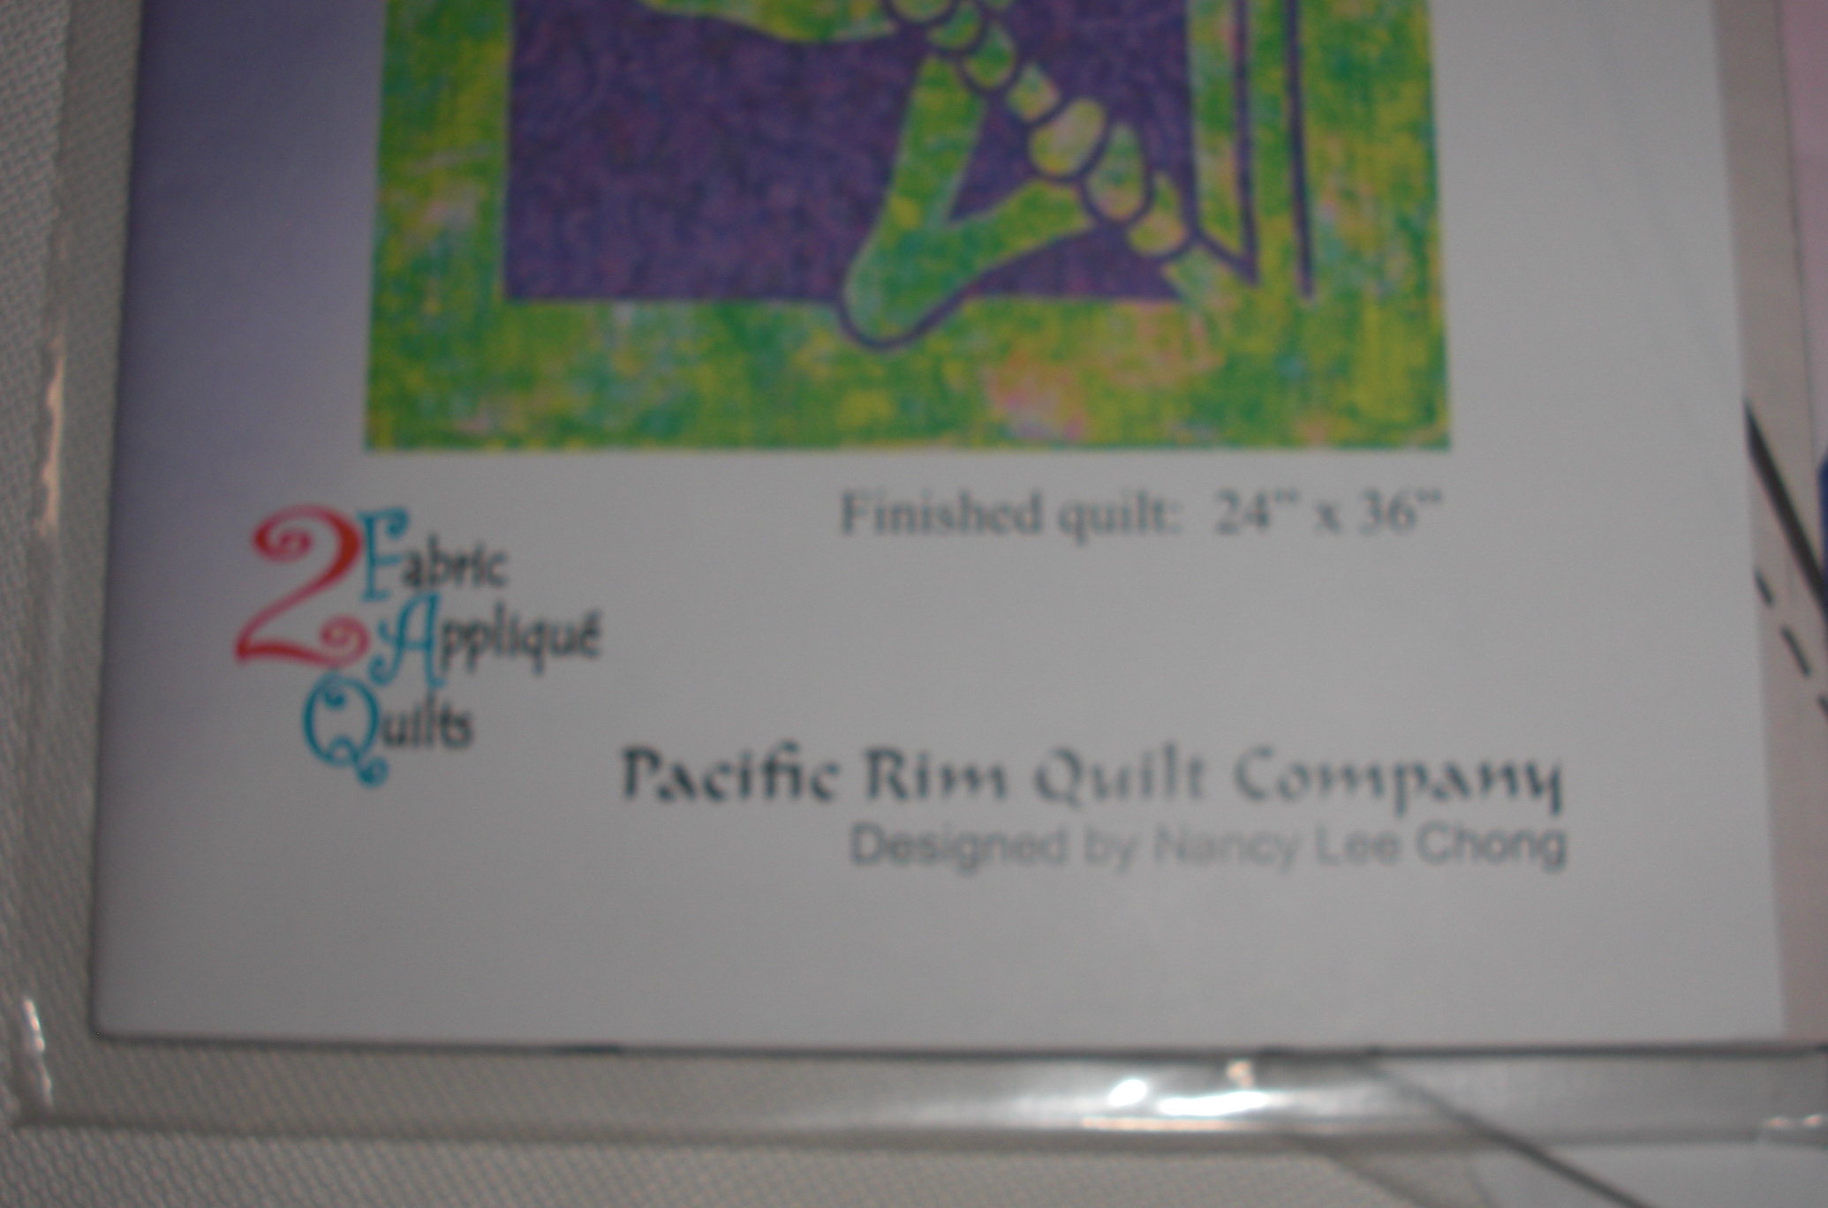
Two-Fabric Applique Patterns from
Pacific Rim Quilt Company

Slide 7
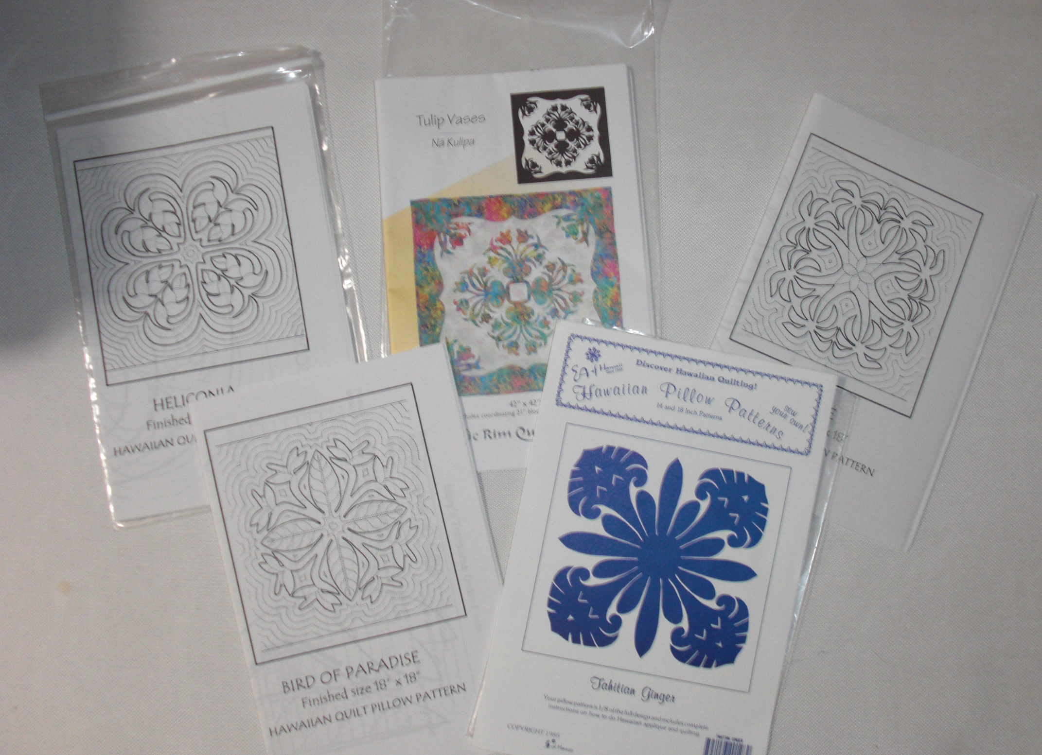
Many sources for patterns and books with Hawaiian Quilt Patterns

Slide 8
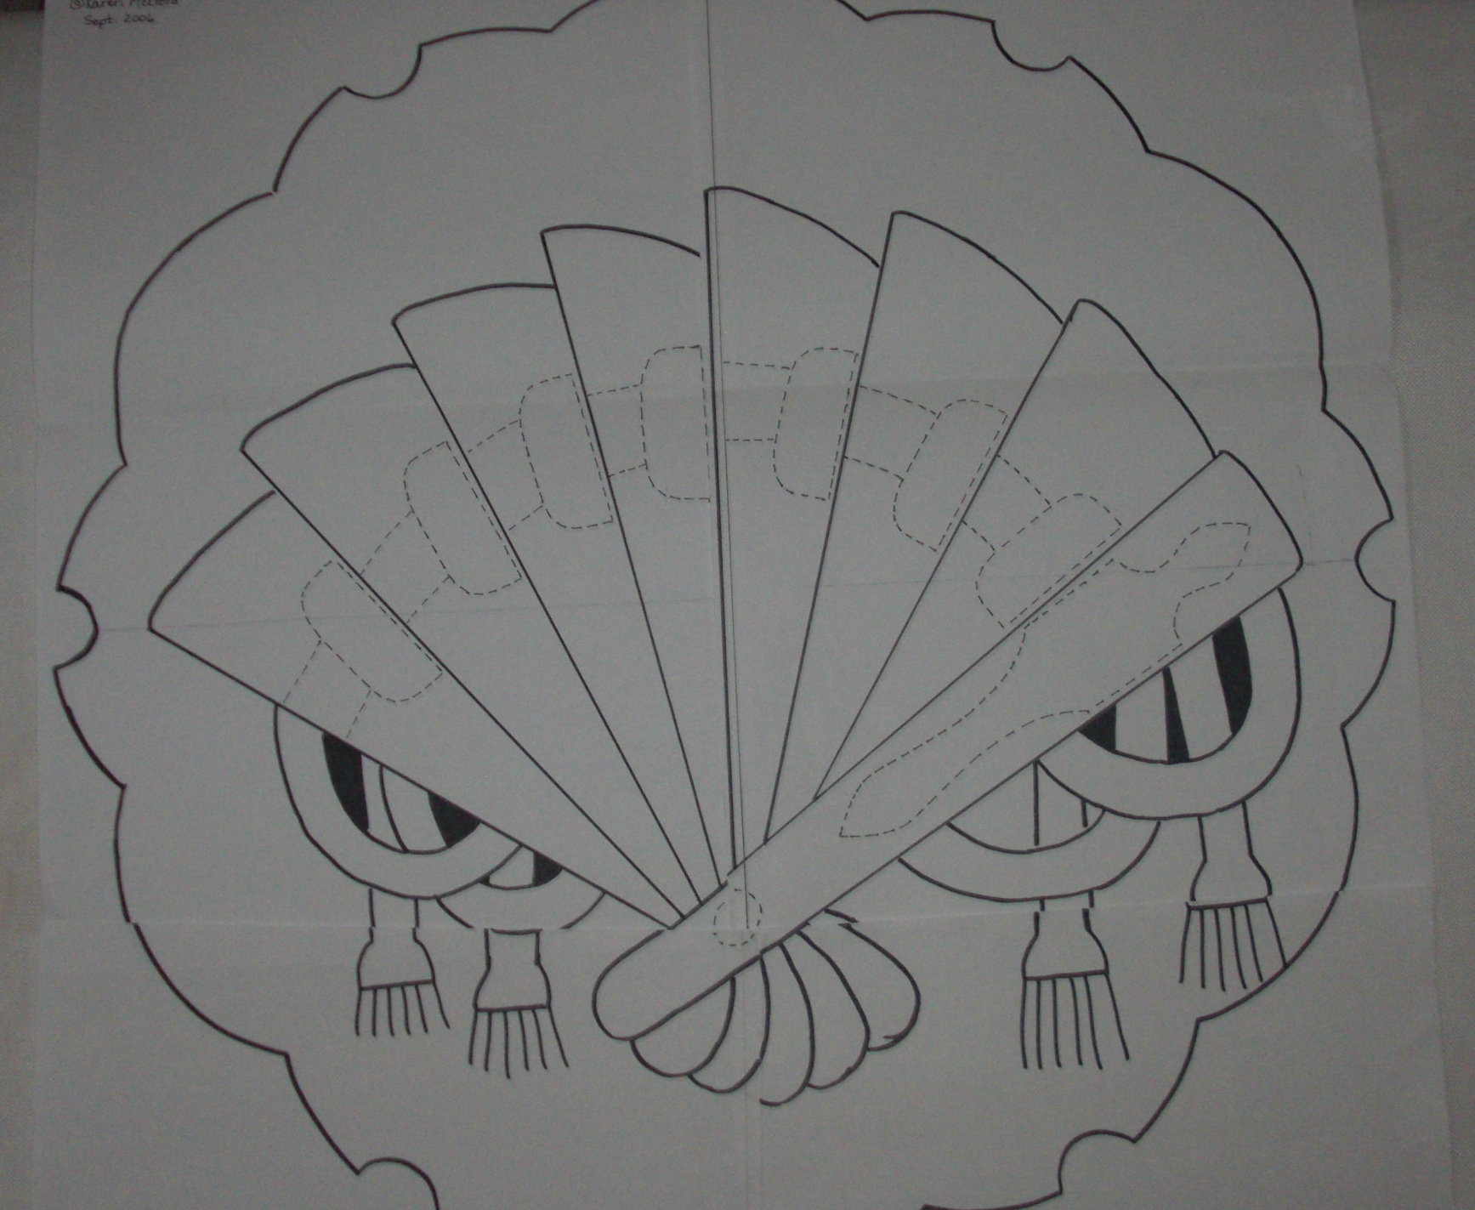
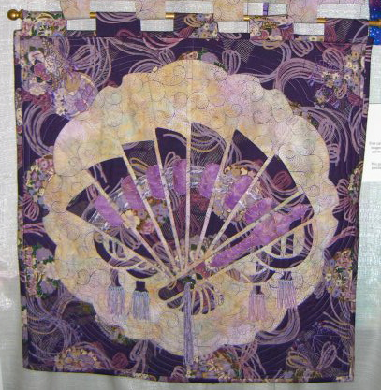
Or design your own!

Slide 9

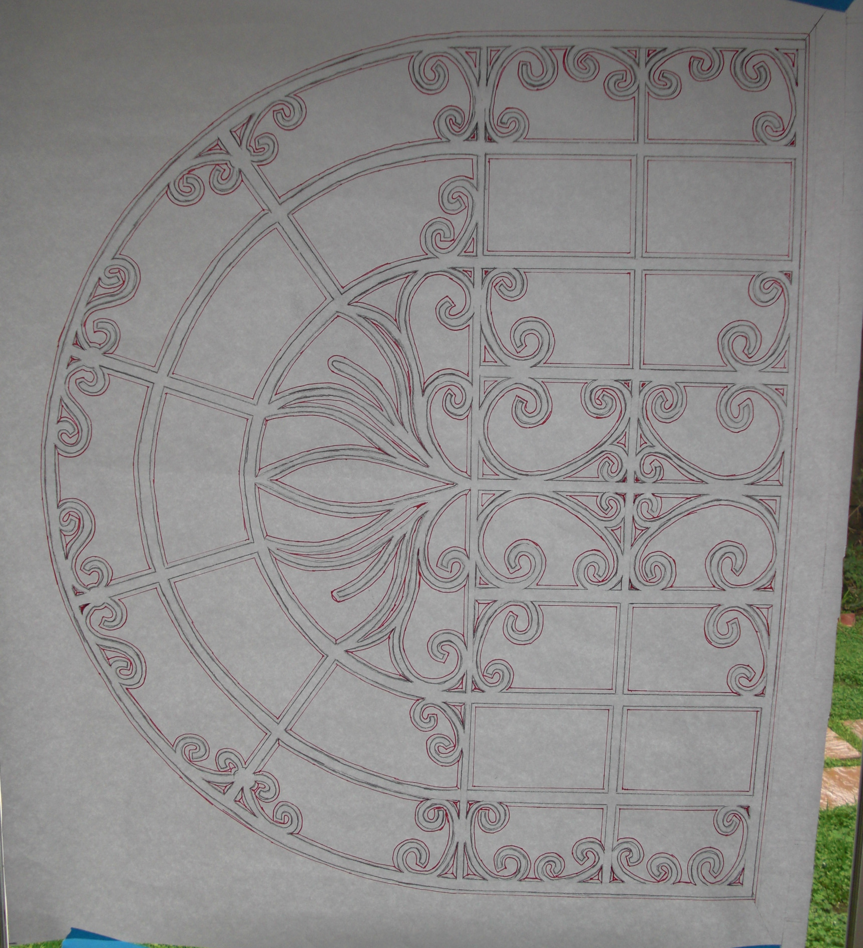
Get your inspiration wherever you go!
Design in progress

Slide 10
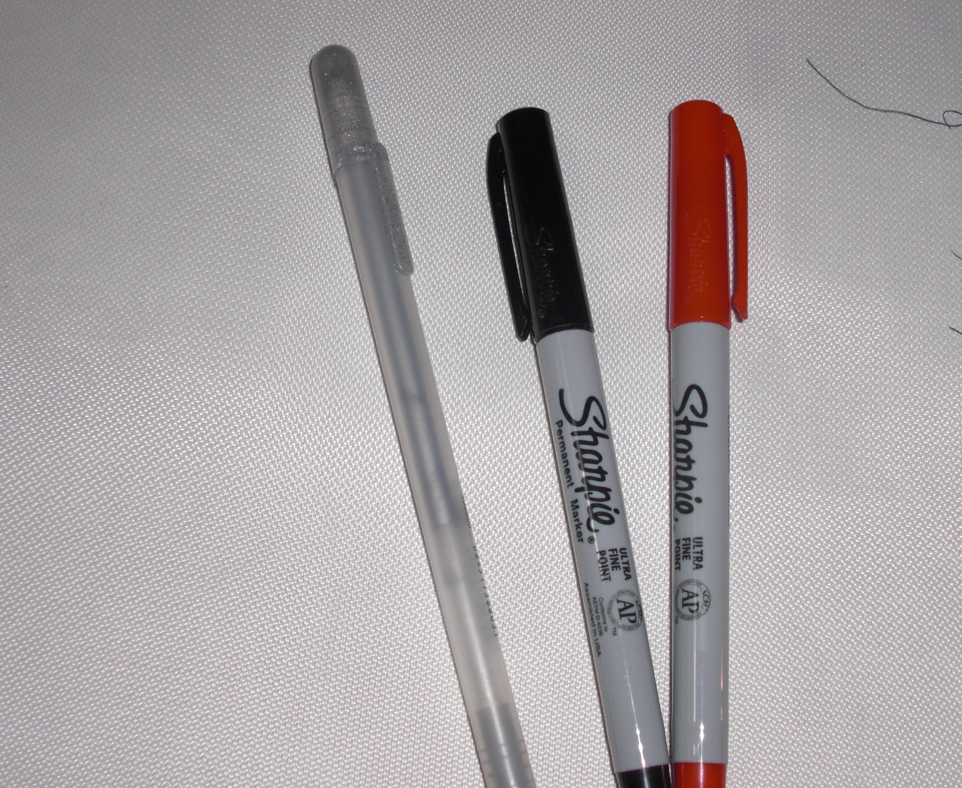
Supplies Needed:
Permanent Ink or Gel Pens – no chalk pencils
Two contrasting fabrics
Pattern
Pins & Applique needles
Thread – basting & applique

Slide 11
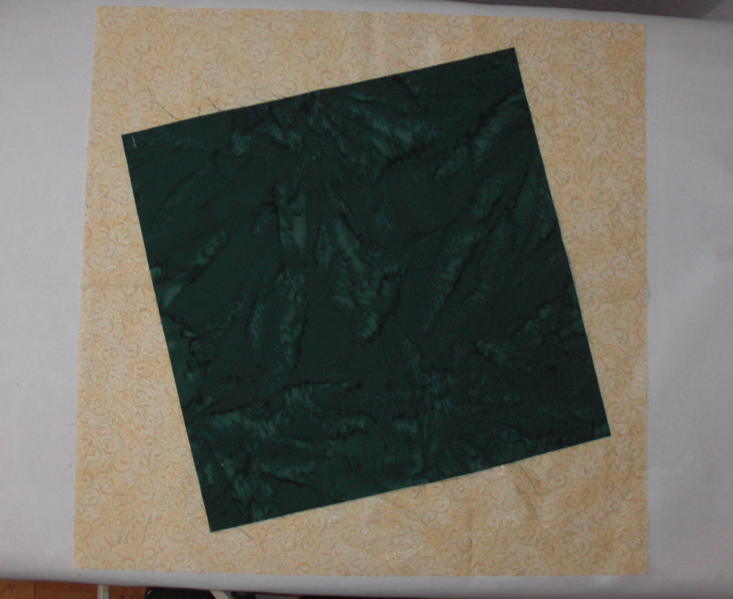
Top and back fabric are usually the same size.
This example is actually a 3-fabric pattern, so the center is cut smaller.

Slide 12
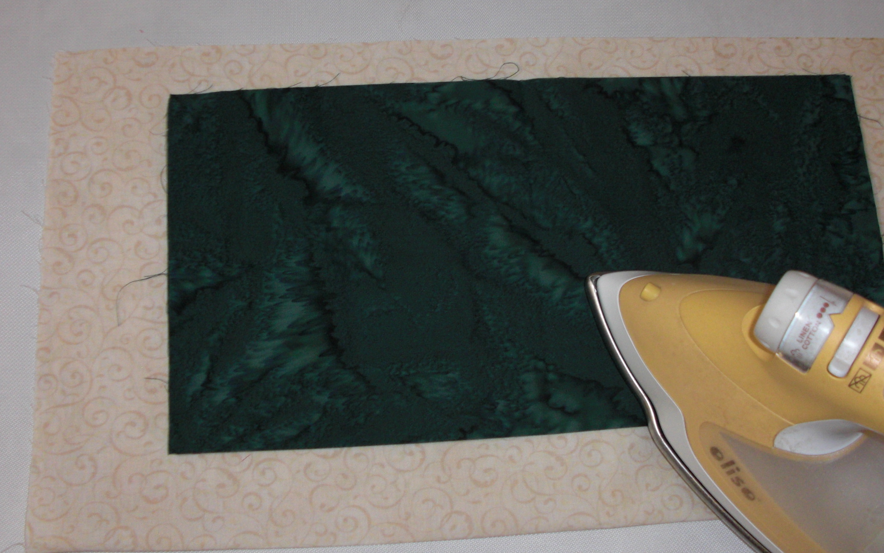
Fold both fabrics in half and press.

Slide 13
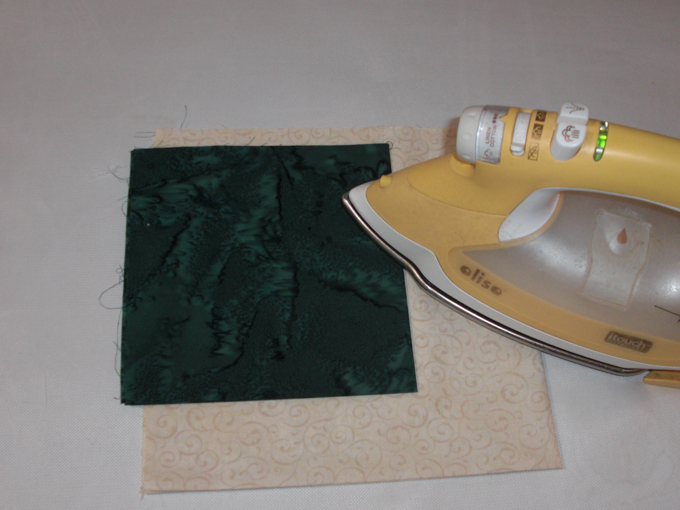
Then fold fabrics in half again and press.

Slide 14
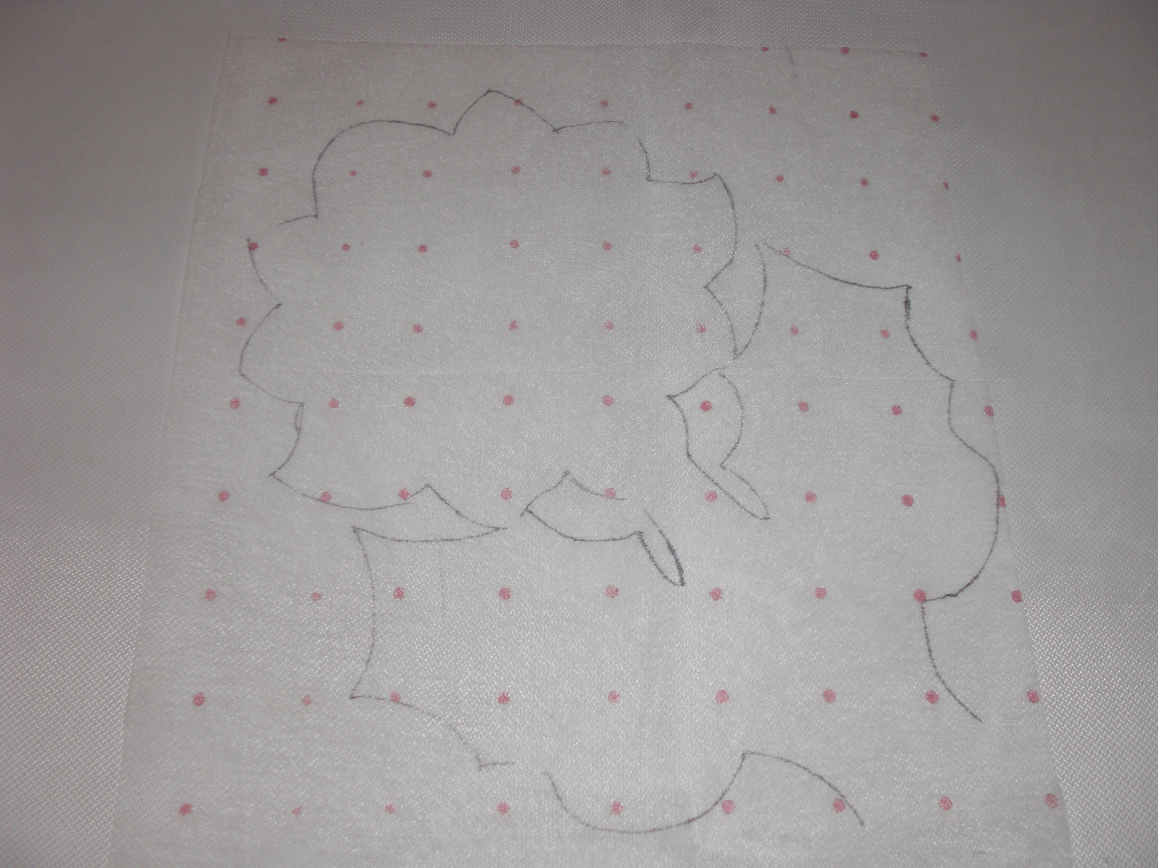
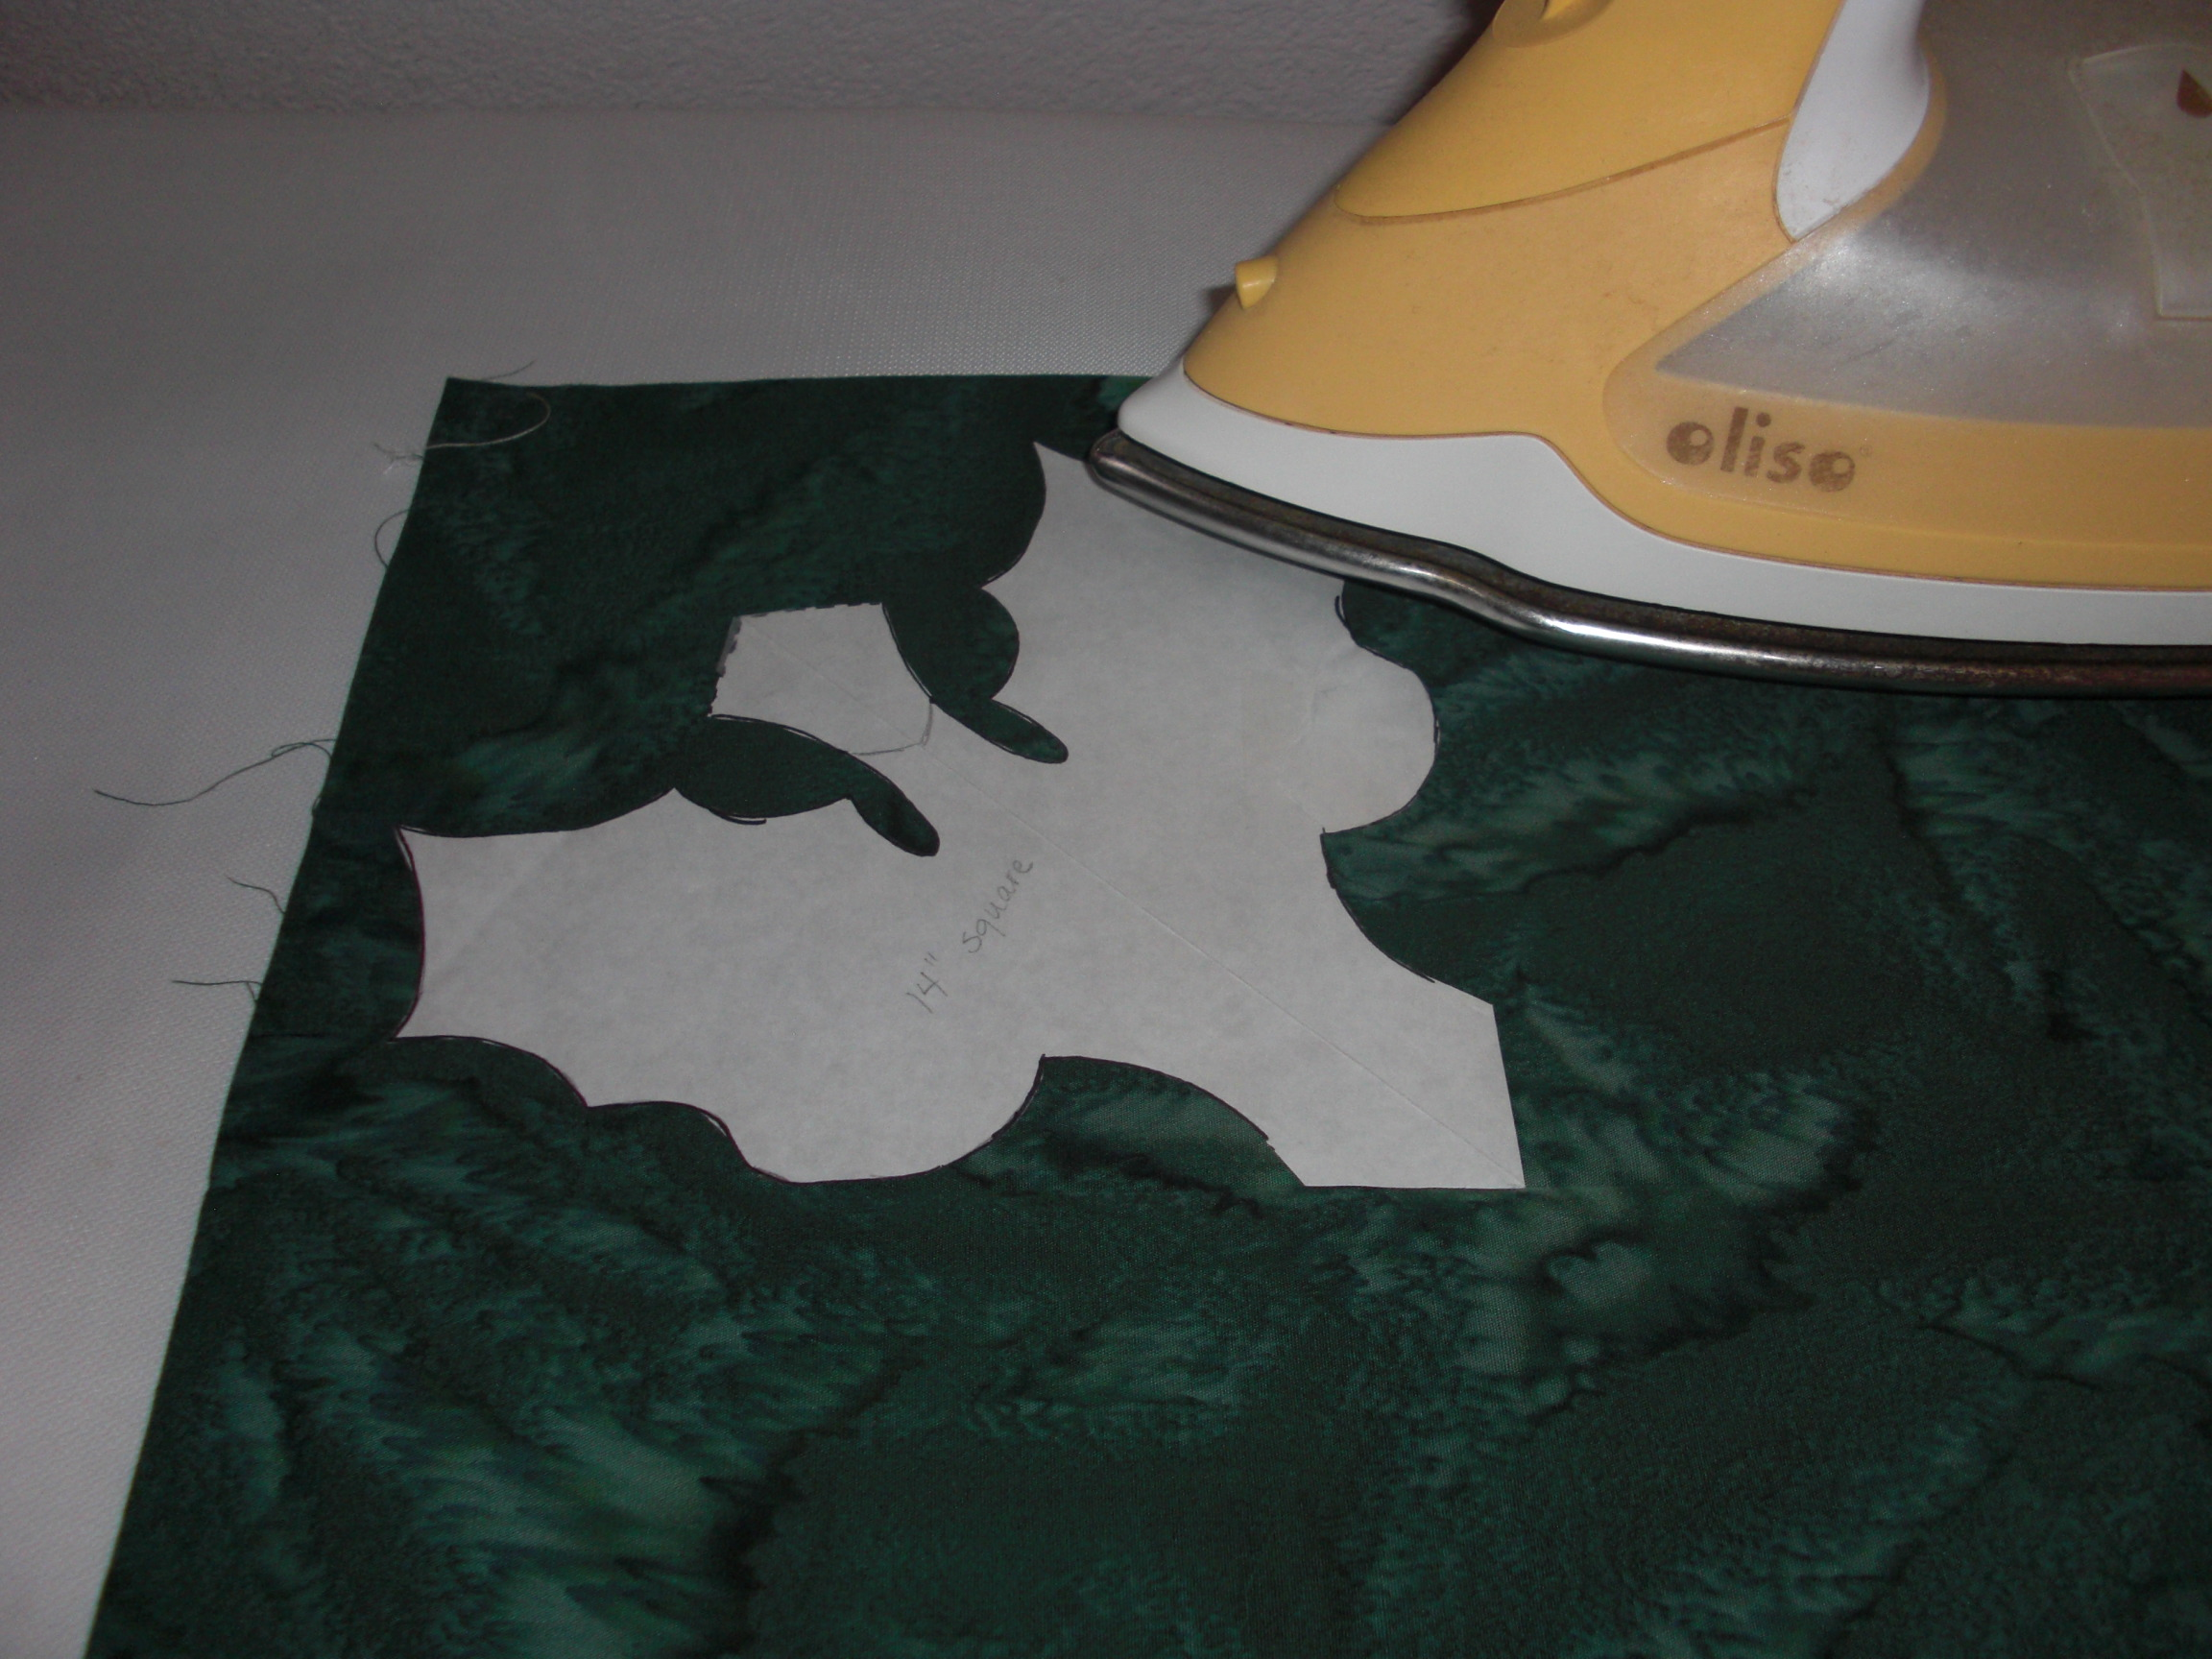
Trace pattern (usually
¼ of design) onto dressmaker’s grid fabric or freezer paper.

Slide 15
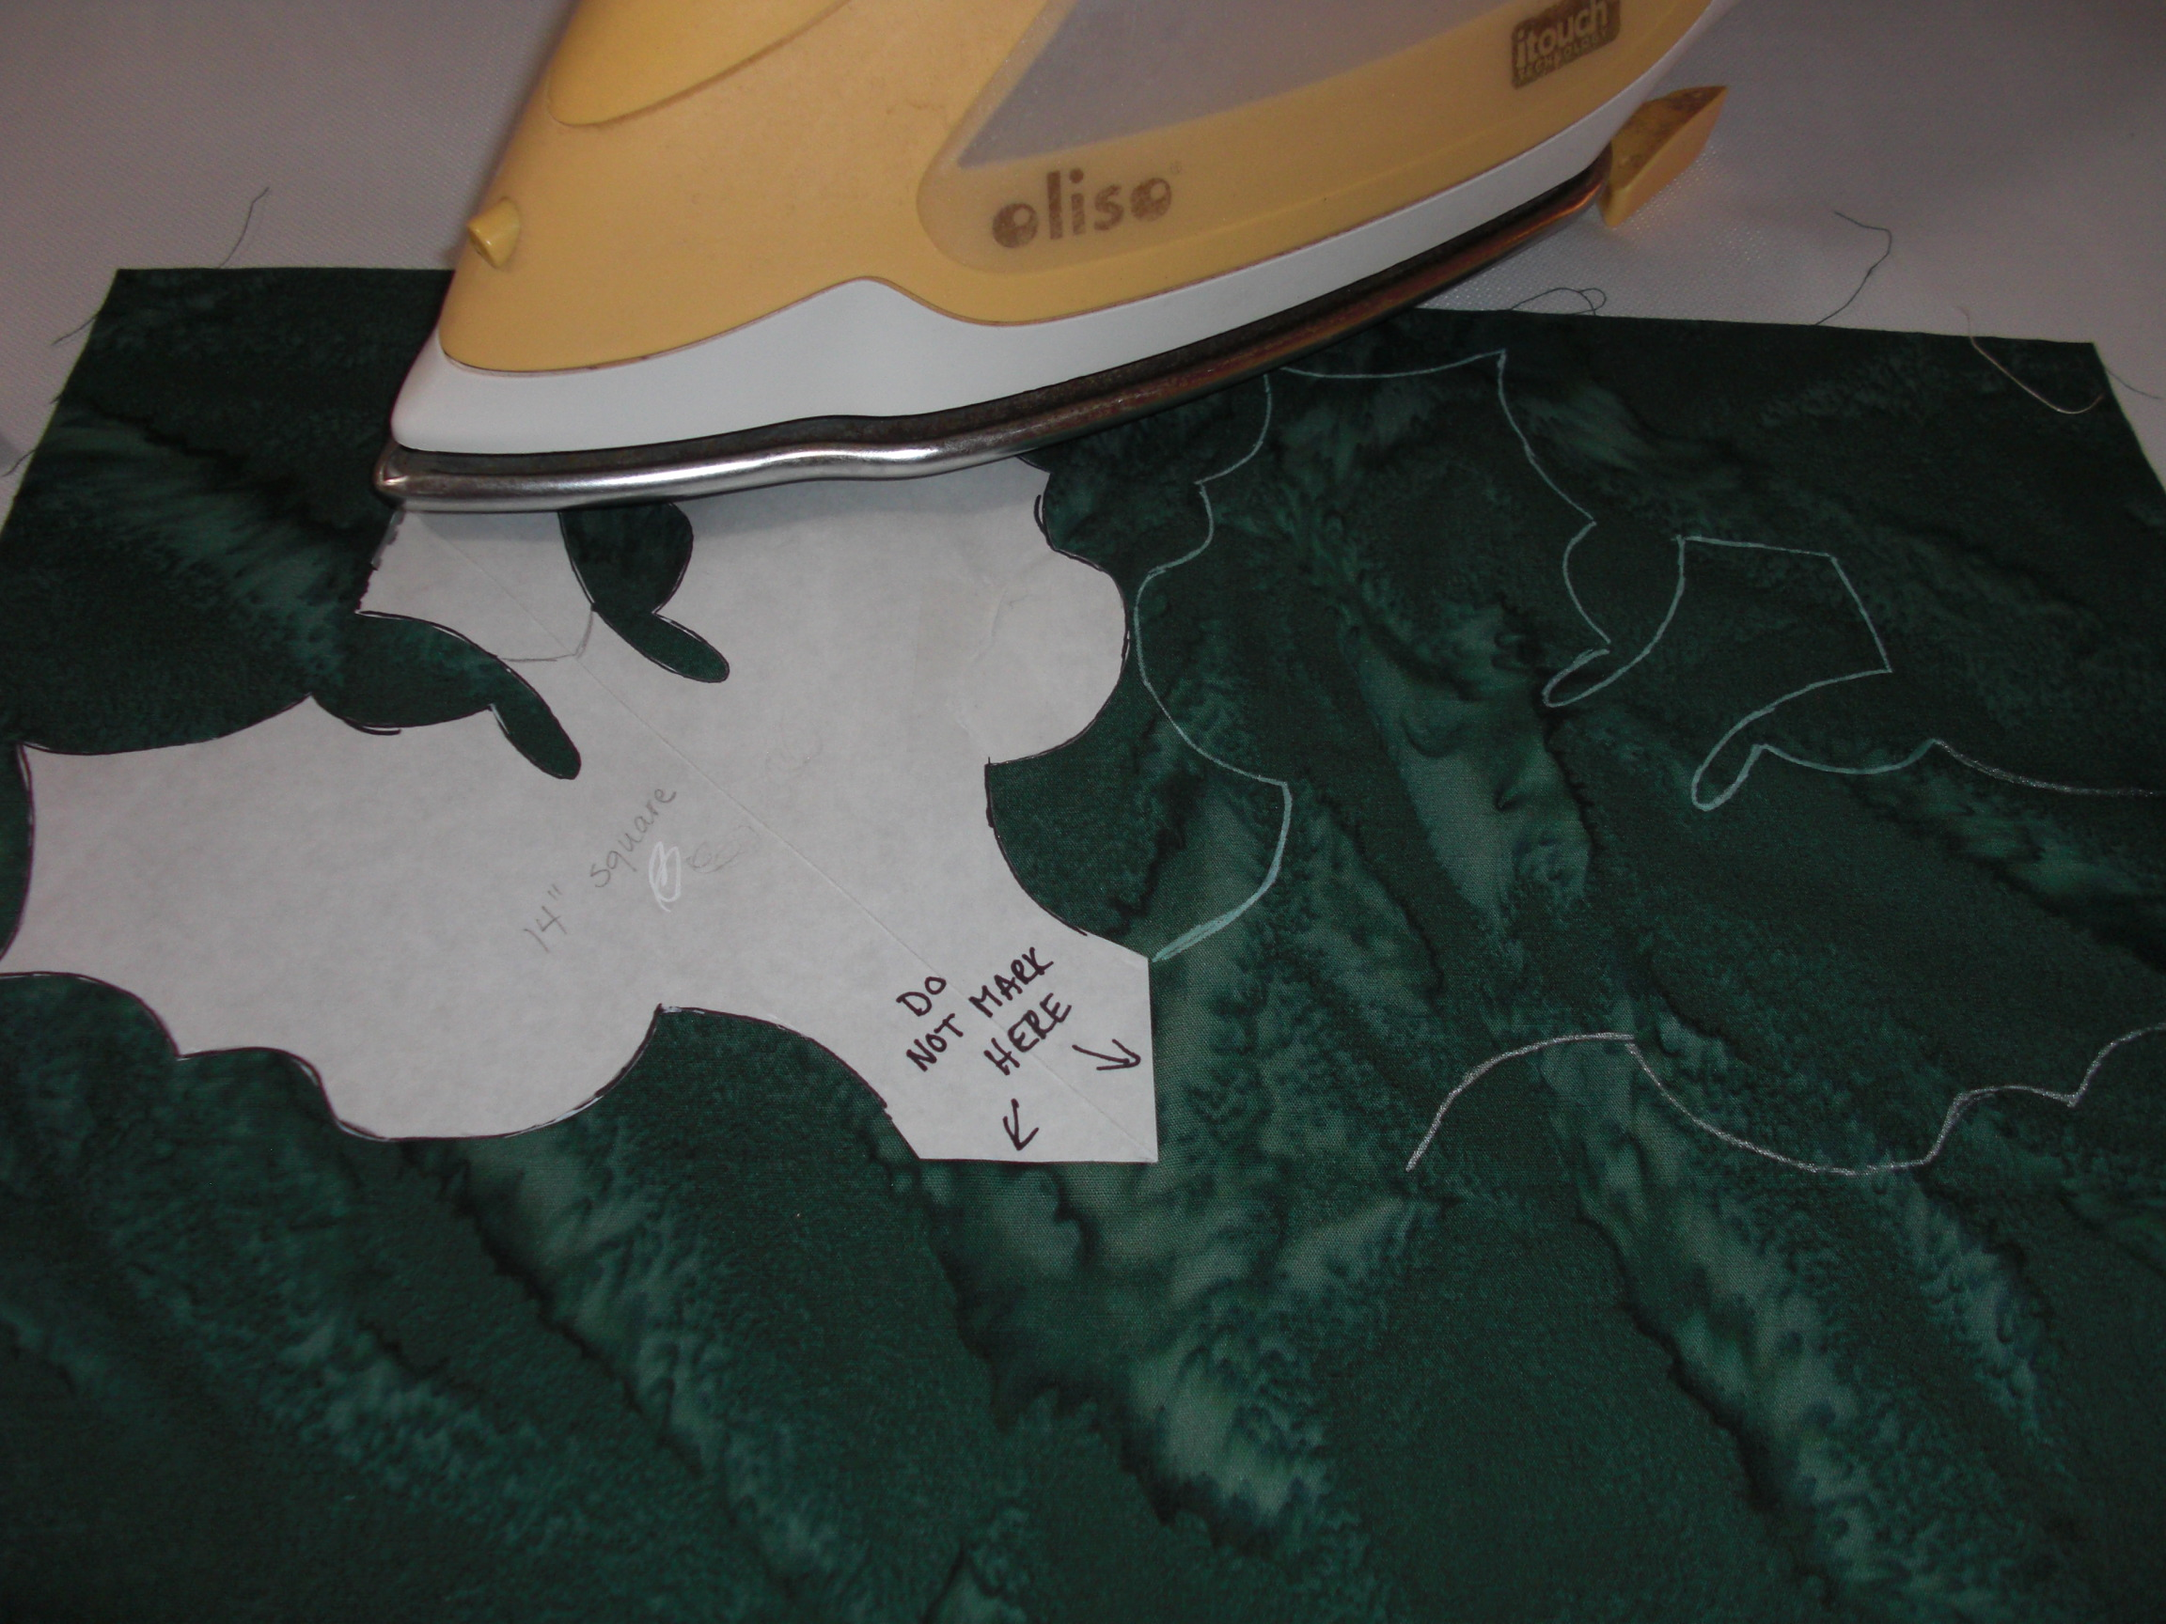
Line up pattern using pressed lines on fabric.
Press freezer in place and trace around using an ink that is easily visible.
Move to the adjoining quarter and trace around pattern again.

Slide 16
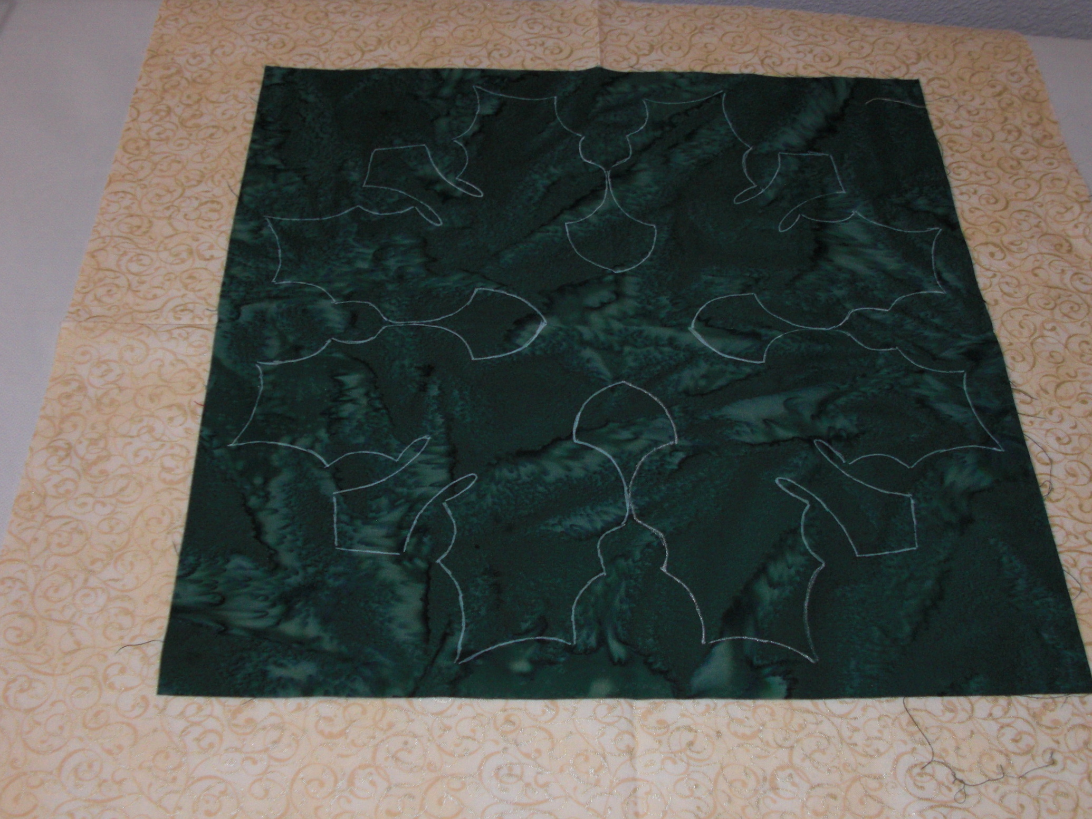
Until you have traced around the entire design.
Center top fabric on background using pressed lines.

Slide 17
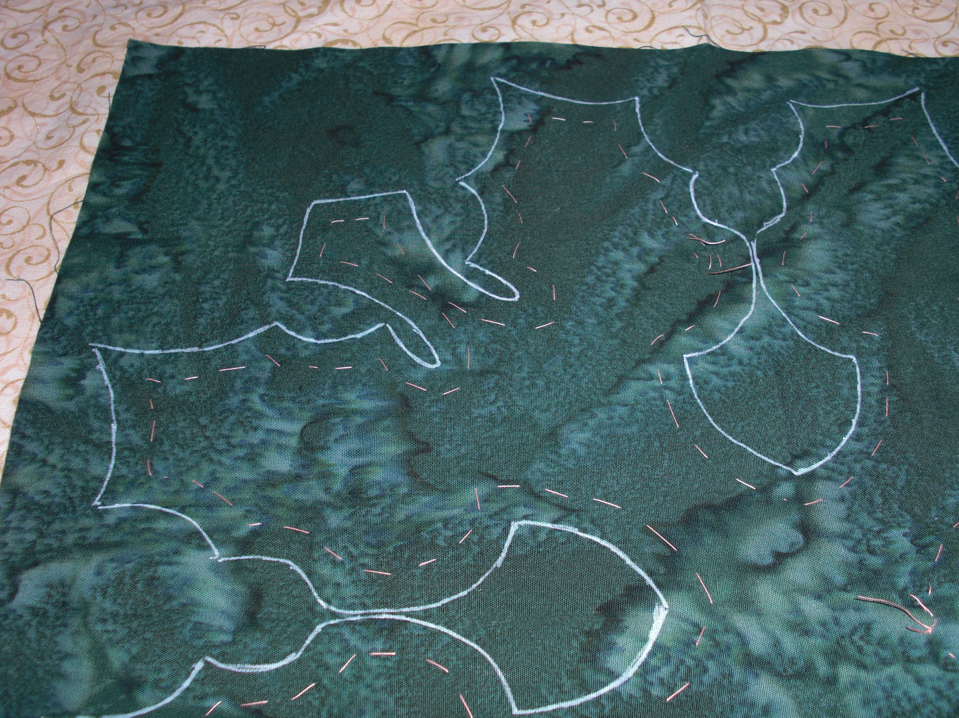
Pin in place and baste about ½ inch inside the lines around the design.

Slide 18
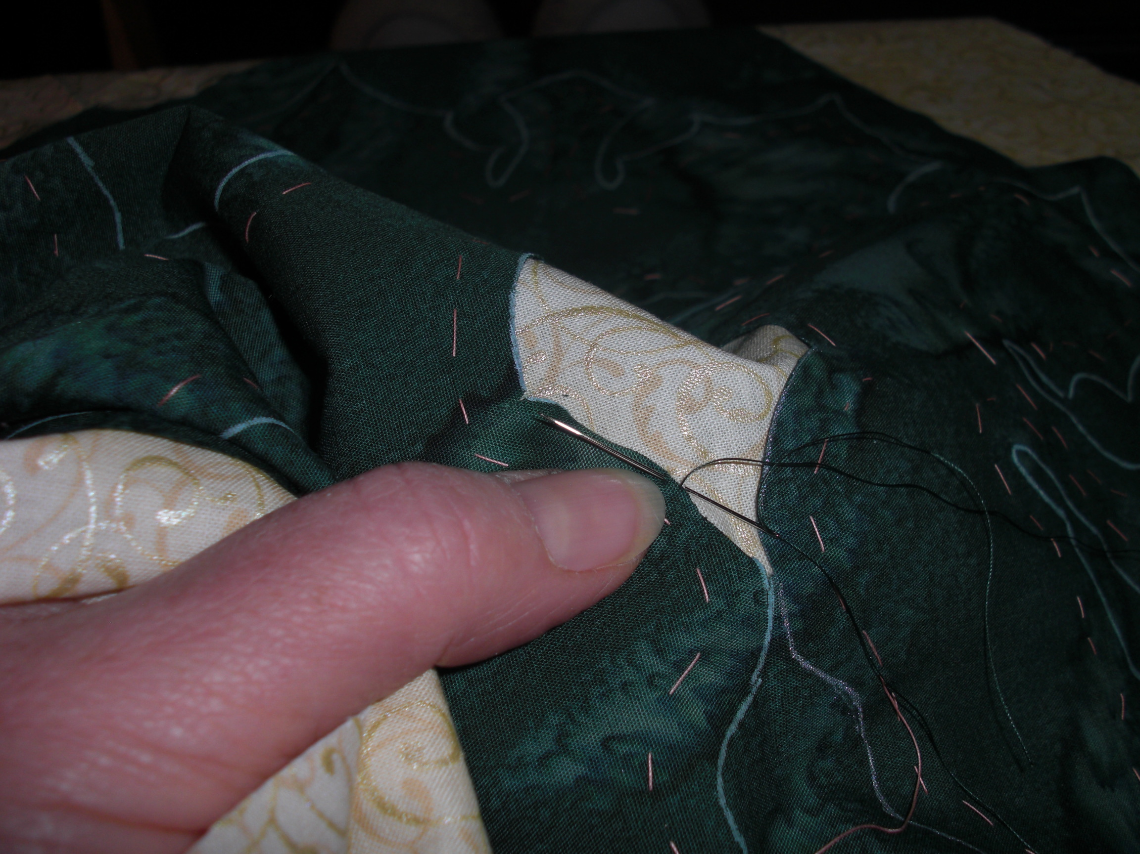
Now the fun begins!
Carefully snip a small hole in the cut-away portion of the top fabric.
Pick a smooth section and begin needle-turn applique, snipping an inch or two along the line as you go.

Slide 19
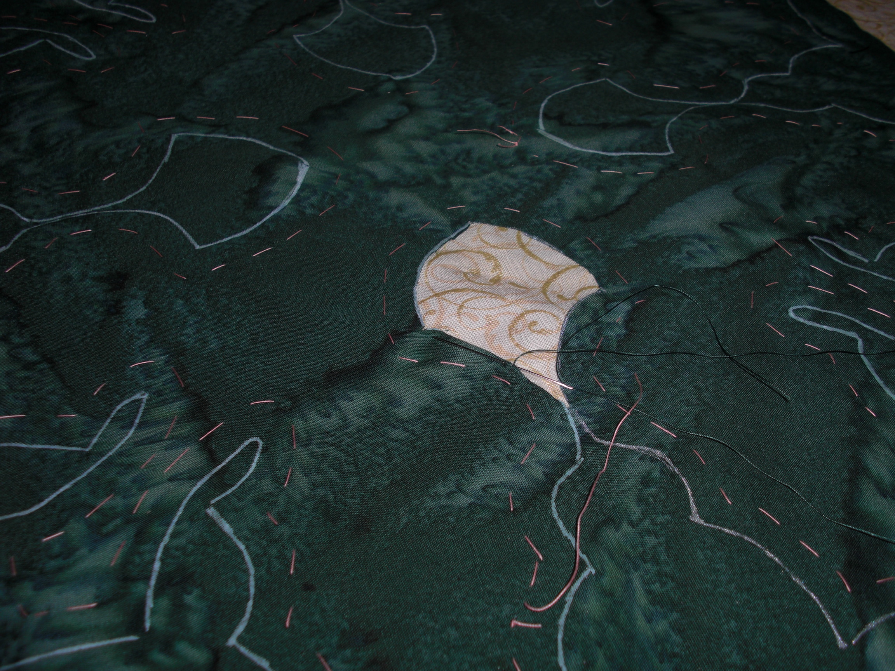
Now watch your design emerge!

Slide 20
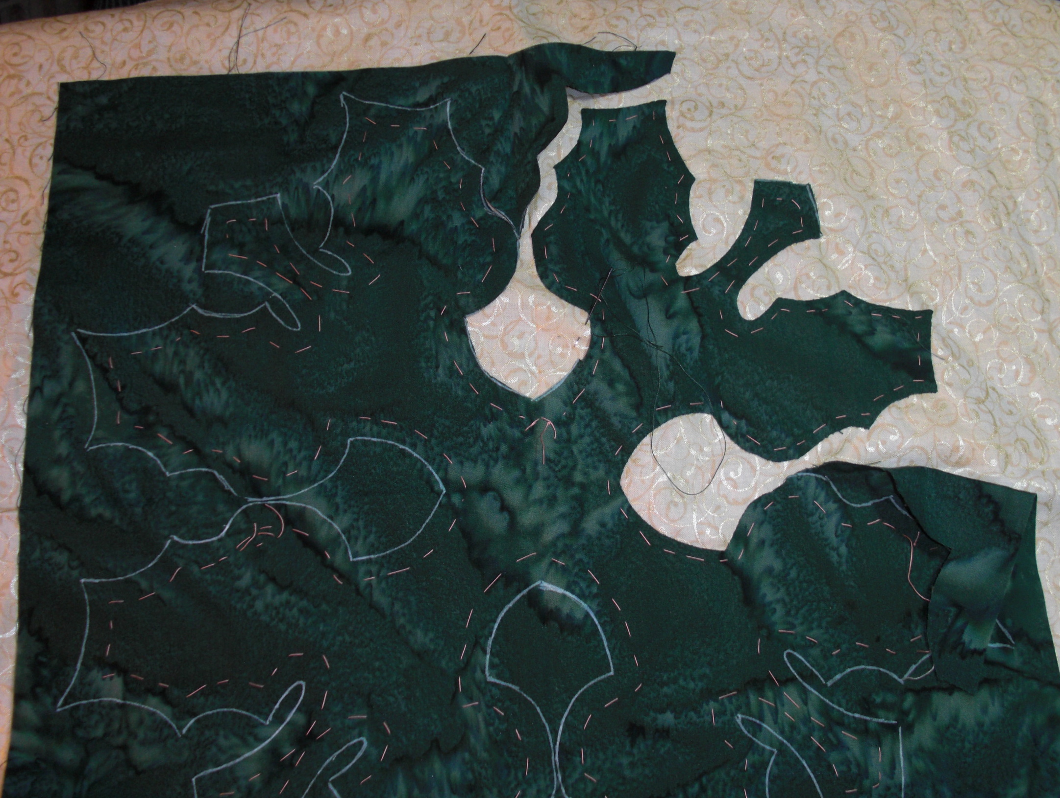

Slide 21
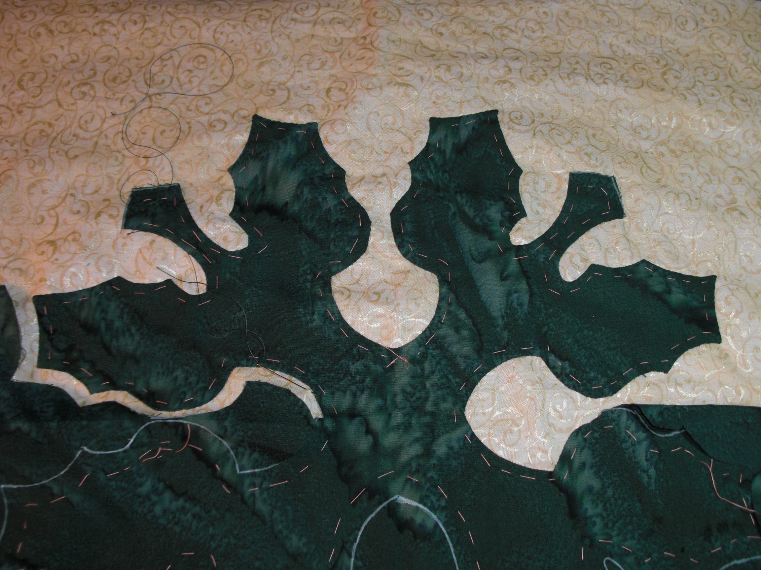

Slide 22
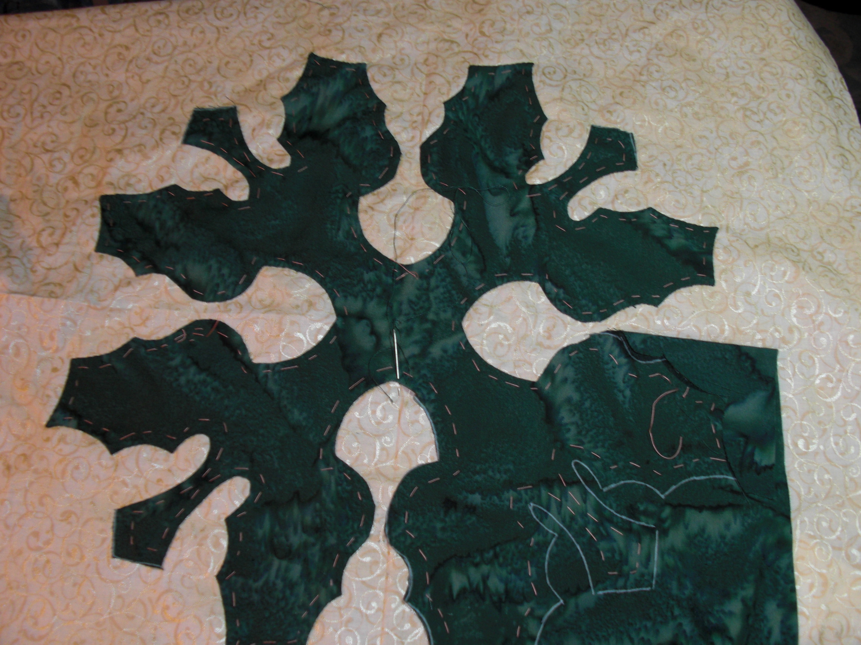

Slide 23
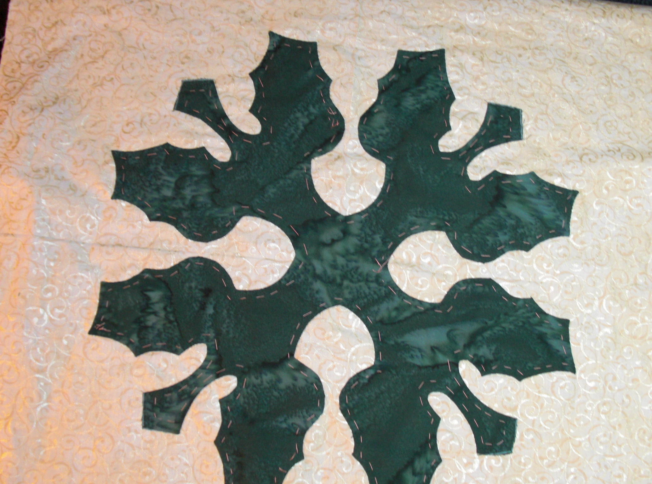

Slide 24
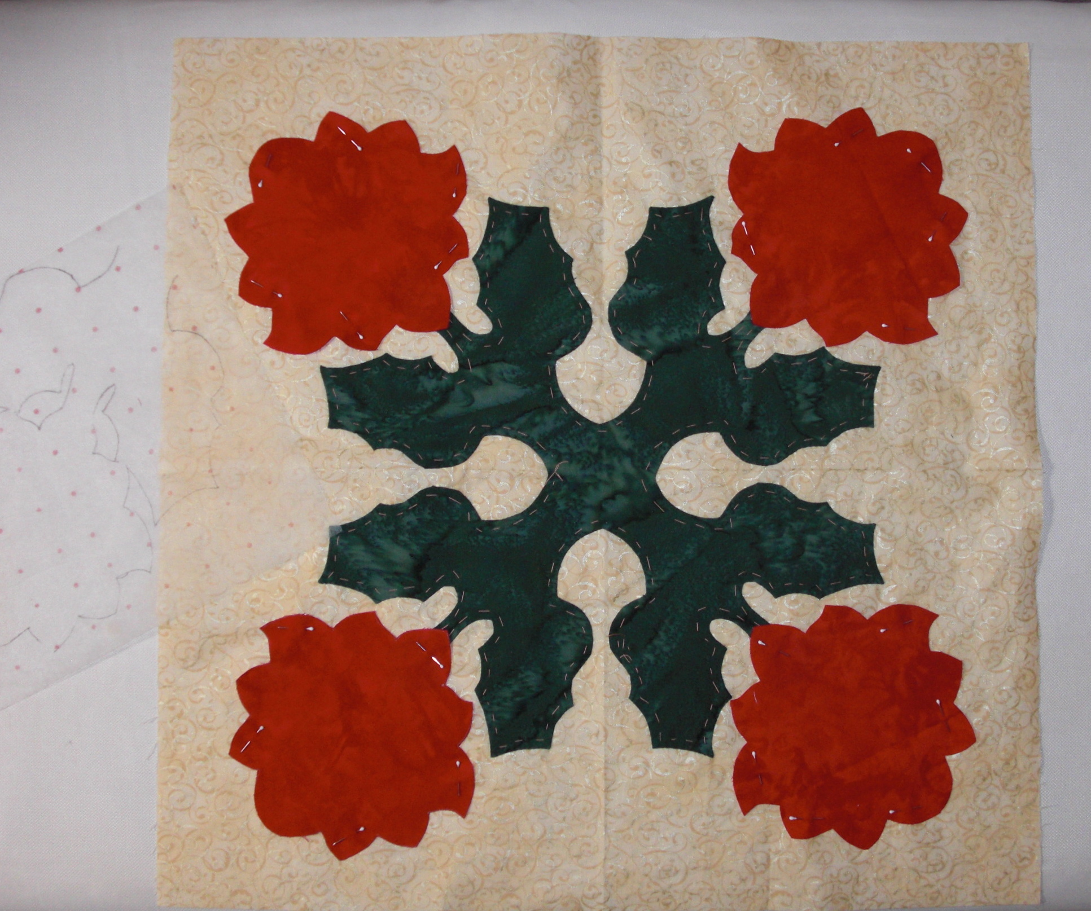
Use dressmaker’s grid pattern to place flowers. Pin and then baste in place.

Slide 25
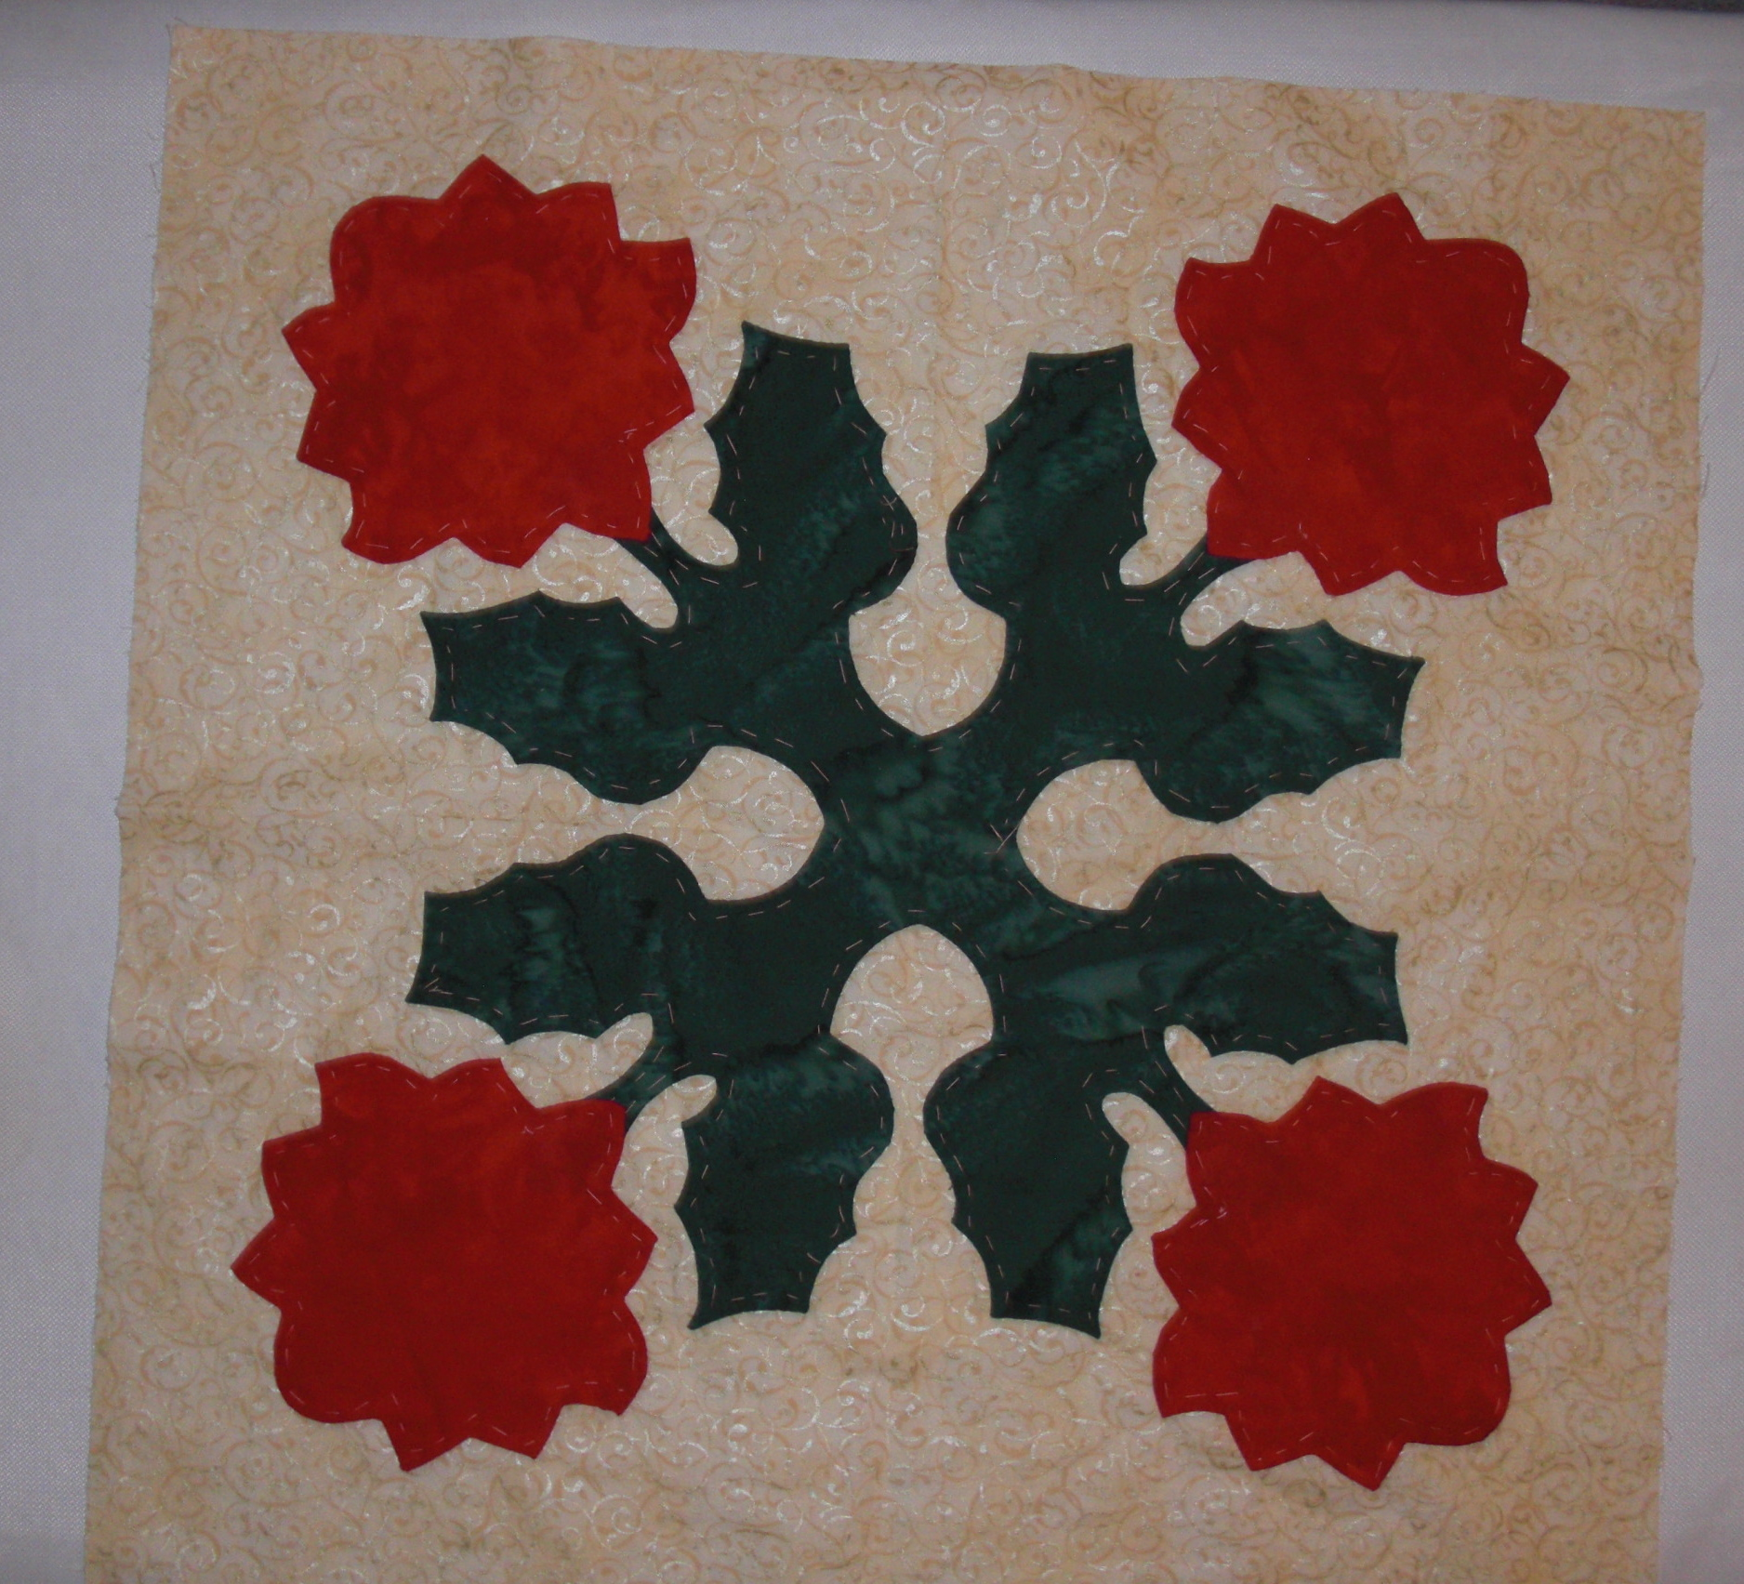
Applique in place.
Remove basting.
Press.
And . . .

Slide 26
